Slide 1
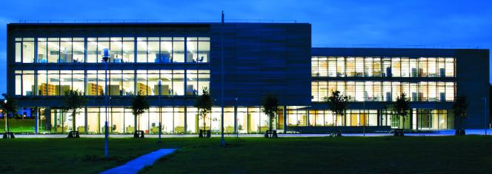
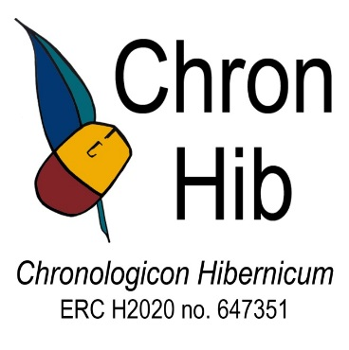



David Stifter, Fangzhe Qiu, Elliott Lash
Introducing
Chronologicon Hibernicum
10th Celtic Linguistics Conference – Maynooth University
4 September 2018
ERC Consolidator Grant 2015, H2020 #647351

Slide 2

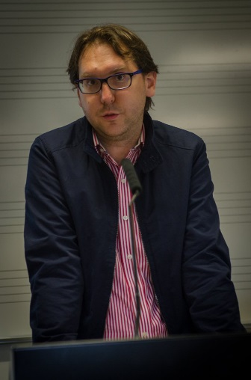
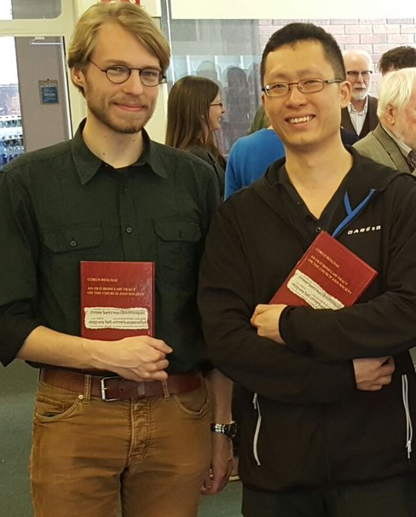
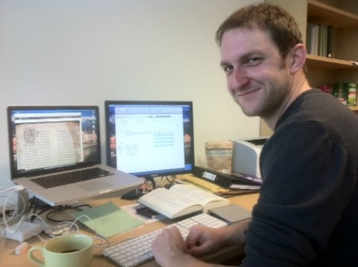

Chronologicon Hibernicum (ERC H2020 #647351)
Maynooth University 2015-2020
Aims and aspirations:
to refine the methodology for dating Early Irish linguistic changes (phonology, morphology, syntax)
to create an absolute chronological framework of changes
to assess variation and change in Early Irish
to apply chronological framework to date texts more precisely
to develop quantitative/statistical ways of determining probabilities for dates
ChronHib team: Dr. Elliott Lash, Dr. Fangzhe Qiu, Dr. Bernhard Bauer (curr. LeXiN); statistician
PhD students: Romanas Bulatovas, Lars Nooij
Research assistants: Ellen Ganly, Tianbo Ji
David Stifter Chronologicon Hibernicum Maynooth University

Slide 3
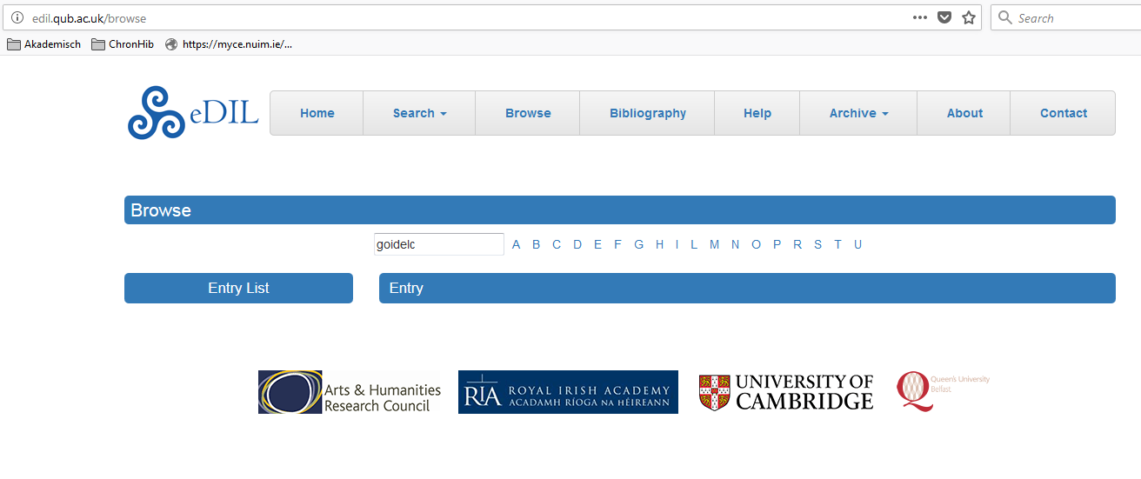
Current Challenges
harmonise structure of databases
develop guidelines for normalised Old Irish and normalised headwords
develop diachronic phonological mark-up
develop diachronic syntactic mark-up
develop quantificational system to assess change
motivate other scholars to use our system
link our databases with eDIL
ChronHib | eDIL
ad⋅condeimnea | adcuindminim
ad⋅gíalla | ad⋅gíall(n)a
agad | agad, aiged
bongaid | boingid
diäs | días
derbae | derba
soër | 1 saer
sáer | 2 saer
David Stifter Chronologicon Hibernicum Maynooth University

Slide 4
Methodology of ChronHib
Subject of study:
Linguistic variations
Their relation to time
Source of Data:
surface forms as recorded in the manuscripts
No modern editorial revision or normalisation
Fangzhe Qiu Chronologicon Hibernicum Maynooth University

Slide 5



Methodology of ChronHib
Source of Data:
Texts from Contemporary Manuscripts (before 950)
Texts that are non-linguistically dated but from later manuscripts
Texts that cannot be dated non-linguistically
Fangzhe Qiu Chronologicon Hibernicum Maynooth University

Slide 6
Methodology of ChronHib
Pre-processing of data
66 texts digitalised and tokenised
http://chronhib.maynoothuniversity.ie
Incorporating some published electronic databases:
Milan Glosses Database (Griffith and Stifter 2013)
Priscian Glosses Database (Bauer 2014)
The Parsed Old- and Middle-Irish Corpus (Lash 2014)
Fangzhe Qiu Chronologicon Hibernicum Maynooth University

Slide 7
Methodology of ChronHib
Pre-processing of data
Tokenisation
a token is a minimally analysable lexical unit called ‘morph’, including lexical preverbs
arnacha·toirsitis ‘so that they might not take her’ (Ml. 48d27)
Morph | Lemma
ar | ara 1
nach | nád 1
a | 3sg.fem.inf.pron.
to | do·
r | ro 1
·toirsitis | do·fich
Fangzhe Qiu Chronologicon Hibernicum Maynooth University

Slide 8
Methodology of ChronHib
Pre-processing of data
Tokenisation
We also recognise tokens that may not be shown in the surface form, e.g.
i·cumtacht ‘in which it was built’
∅ = -(s)a ‘that which’
∅ = *uss (preverb)
do·beir ‘who gives’
∅ = leniting relative particle
Fangzhe Qiu Chronologicon Hibernicum Maynooth University

Slide 9
Methodology of ChronHib
Pre-processing of data
111,272 tokens (and growing!)
Linguistic annotation
lemmatisation
POS- and morphological tagging
syntactic parsing
Variation tagging
Fangzhe Qiu Chronologicon Hibernicum Maynooth University

Slide 10
Methodology of ChronHib
Pre-processing of data
Linguistic annotation
2. POS- and morphological tagging
Tagset: 22 POS tags, 603 morphological tags
Other tags:
nominal stem class
verbal class
deponentiality and dependency of verbs
onomastic usage of compound proper names etc.
Fangzhe Qiu Chronologicon Hibernicum Maynooth University

Slide 11
Methodology of ChronHib
Pre-processing of data
Linguistic annotation
2. POS- and morphological tagging
The complexity of Old Irish morphology
Allomorphs sharing the same tag
homonyms which should be tagged differently
e.g. the relative negative particle
nad, nach, na, nacon etc.
e.g. macc which can be nom., voc., acc. and dat. sg.
Fangzhe Qiu Chronologicon Hibernicum Maynooth University

Slide 12
Methodology of ChronHib
Pre-processing of data
Linguistic annotation
2. POS- and morphological tagging
Morph | Lemma | POS | Subclassification | Gender | Meaning | Morphological Analysis
ar | ara 1 | conjunction |  |  | so that, in order that
nach | nád 1 | particle | Neg.subord. |  | that not
a | 3sg.fem.inf.pron. | pronoun |  |  | her | Class C
to | do· | particle | preverb
r | ro 1 | particle | augment |  | perfective or potential aspect
·toirsitis | do·fich | verb | S1 |  | to take, to attack | aug.3pl.past.subj.
Fangzhe Qiu Chronologicon Hibernicum Maynooth University

Slide 13
Methodology of ChronHib
Pre-processing of data
Linguistic annotation
4. Variation tagging
A table listing 326 linguistic variations
phonological, orthographical, morphological, syntactical and lexical variations
Fangzhe Qiu Chronologicon Hibernicum Maynooth University

Slide 14
Methodology of ChronHib
Pre-processing of data
Linguistic annotation
4. Variation tagging
Morph | Var.ID | Var.Description | Value
Achid | OR005 | use <ai> instead of earlier <i> to represent the schwa in the unstressed syllable Cə C'. | No
das | MO072 | use of new infixed pronoun forms instead of old ones | Yes
Feradach | PH029 | posttonic, non-final short vowels are reduced to schwa. | Maybe
Fangzhe Qiu Chronologicon Hibernicum Maynooth University

Slide 15
Methodology of ChronHib
Data analysis
Synchronic linguistic profiles
Statistical analysis
Diachronic linguistic profile
Testing of the absolute chronology
Fangzhe Qiu Chronologicon Hibernicum Maynooth University

Slide 16
Methodology of ChronHib
Data analysis
Synchronic linguistic profiles
Examples of variations in Vita Sancti Columbae, Schaffhausen MS
ID | Description of variation | n (tokens) | No | Yes | Maybe | Yes percentage in all tokens
PH006 | breaking of /e:/ > /iə/. | 16 | 15 | 1 | 0 | 6.25%
PH008 | posttonic, non-final short vowels are reduced to schwa.. | 212 | 147 | 41 | 24 | 19.34%
PH010 | final unstressed /o/ > /a/ | 13 | 13 | 0 | 0 | 0.00%
PH013 | reducing of final unstressed /a/, /e/, /i/ to schwa. | 145 | 136 | 1 | 8 | 0.69%
PH015 | /oi̯/ becomes /ai̯/. | 25 | 24 | 1 | 0 | 4.00%
PH025 | /nd/ becomes /nn/ or /N/ in places other than proclitics | 30 | 30 | 0 | 0 | 0.00%
PH028 | loss of /u̯/ between a consonant and a vowel | 17 | 0 | 17 | 0 | 100.00%
Fangzhe Qiu Chronologicon Hibernicum Maynooth University

Slide 17

Elliott Lash
Syntactic Parsing of ChronHib databases

Slide 18
POMIC: A pilot study for syntactic parsing of ChronHib
Introduced at the Celtic Linguistics Conference in 2012 (Rennes)
Published online in 2014.
Hosed by Dublin Institute for Advanced Studies
https://www.dias.ie/celt/celt-publications-2/celt-the-parsed-old-and-middle-irish-corpus-pomic/).
Elliott Lash Chronologicon Hibernicum Maynooth University

Slide 19
POMIC citations: The scope of possibilities of a parsed corpus
DiGirolamo, C., 2018. ‘Word Order and Information Structure in the Würzburg Glosses,’ in Ana Maria Martins and Adriana Cardoso (eds) Word Order Change. OUP.
Lash, E and A. Griffith, 2018. ‘Coordinate Subjects, Expletives, and the EPP in Early Irish,’ Journal of Celtic Linguistics 19, 87-156.
Walkden, G. 2018. ‘Proto-Indo-European: A Language without Merge?,’ Handout for Diachrony in Generative Syntax 20, York University. 18-21 June.
Doyle, A., J. P. McCrae, C. Downey, 2018. ‘Preservation of Original Orthography in the Construction of an Old Irish Corpus.
Le Mair, E., C. A. Johnson, M. Frotscher, T. Eythórsson, and J. Barðdal, 2017. ‘Position as a behavioral property of subjects: The case of Old Irish,’ Indogermanische Forschungen 122: 111–142.
Jongeleen, S. 2016. Lenition of the Conjugated Prepositions in Irish and Welsh. RMA Thesis, Utrecht University.
Mitrović, M. 2014. Morphosyntactic atoms of propositional logic (a philo-logical programme). PhD Thesis, Cambridge University.
Lash, E. 2014. ‘Subject positions in Old and Middle Irish,’ Lingua 148, 278-308.
Elliott Lash Chronologicon Hibernicum Maynooth University

Slide 20
POMIC v. ChronHib
POMIC version 1 (Lash 2014):
14 Old and Middle Irish texts
31,958 words
ChronHib corpus
66 Old Irish texts
111,272 Tokens
Elliott Lash Chronologicon Hibernicum Maynooth University

Slide 21
POMIC v. ChronHib
- Text types
a. texts in contemporary Old Irish manuscripts,
b. Old Irish texts in later manuscripts
c. non-linguistically dated texts.
POMIC Examples
a. Book of Armagh Additamenta (9th c. manuscript, 8th c. text)
b. Monastery of Tallaght (15th c. manuscript, 9th c. text)
c. The three Drinking Horns of Cormac úa Cuinn (unclear)
Elliott Lash Chronologicon Hibernicum Maynooth University

Slide 22
POMIC v. ChronHib
57 glossed manuscripts in the ChronHib corpus.
Typically one word glosses, or short nominal or prepositional phrases
Occasionally more complex constructions
At least 657 verb phrases in the Minor Glosses section of the ChronHib corpus
Minor Glosses = glossed contemporary Old Irish manuscripts excluding Würzburg, Milan, and Priscian glosses.
Elliott Lash Chronologicon Hibernicum Maynooth University

Slide 23
Quick overview of the Syntactic Parsing System
Penn-style phrase-structure treebank of Old Irish.
This annotation method facilitates easy automatic search at the expense of higher-level theoretical accuracy.
Tree structures do not contain all of the structure usually found in a full phrase-structure tree, if a construction can be found unambiguously through a combination of the properties of bracketed phrases (i.e. precedence, dominance etc.).
After searching for and assembling examples, theoretical claims can be made and accurate phrase-structure diagrams can be proposed.
Elliott Lash Chronologicon Hibernicum Maynooth University

Slide 24
Quick overview of the Syntactic Parsing System
a. POS-Based Tags:
NP = noun phrase, PP = prepositional phrase, ADJP = adjective phrase, ADVP = adverb phrase, CP = complementizer phrase
b. Functional Tags
-SBJ = subject, -OBJ = object, -POS = possessive, -COM = complement, -REL = relative, -CMP = comparative
Predicate-level Tags
IP = ‘inflectional’ phrase’
d. Predicate-level functional tags:
-MAT = matrix, -SUB = subordinate
e. Empty Categories: *T* = Trace
Elliott Lash Chronologicon Hibernicum Maynooth University

Slide 25
Quick overview of the Syntactic Parsing System
a. POS-Based Tags:
NP = noun phrase, PP = prepositional phrase, ADJP = adjective phrase, ADVP = adverb phrase, CP = complementizer phrase
b. Functional Tags
-SBJ = subject, -OB1 = object, -POS = possessive, -COM = complement, -REL = relative, -CMP = comparative
Predicate-level Tags
IP = ‘inflectional’ phrase’
d. Predicate-level functional tags:
-MAT = matrix, -SUB = subordinate
e. Empty Categories: *T* = Trace
Elliott Lash Chronologicon Hibernicum Maynooth University

Slide 26
Quick overview of the Syntactic Parsing System
Abbreviated example from POMIC:
di-géni cummen cétaig ríthae fri éladach ... ar ech ndonn
"Cummen made a mantle which was sold to Eladach... for a brown horse."
( (IP-MAT (ID arm.23) ...
(PV+VBD di-géni)
(NP-SBJ (NPR-N cummen))
(NP-OB1 (N-A cétaig)
(CP-REL (WNP-1 0)
(C 0)
(IP-SUB (VBD-PASS ríthae)
(NP-SBJ (NP *T*-1))
(PP (P fri)
(NP (NPR-A éladach) ...
(PP (P ar)
(NP (N-A ech)
(NAS n)
(ADJ-A donn))))))
Elliott Lash Chronologicon Hibernicum Maynooth University

Slide 27
Deriving a treebank from the ChronHib corpus
Step (1)
Take a sentence:
… nicon imruldatar cosa doine riam lar srotha iordanein
"Men’s feet had never before tread the bed of the river Jordan."
(ChronHib 0050.046; Turin Gospel Commentary, Thes. i 488.65)
Elliott Lash Chronologicon Hibernicum Maynooth University

Slide 28
Deriving a treebank from the ChronHib corpus
nicon imruldatar cosa doine riam lar srotha iordanein
Step (2a)
Take the morphological analysis found in tagged fields in database
Elliott Lash Chronologicon Hibernicum Maynooth University

Slide 29
Deriving a treebank from the ChronHib corpus
nicon imruldatar cosa doine riam lar srotha iordanein
Step (2b)
Rearrange morphological tagging into tuples (tag + word pairs)
[ANALYSIS_POS/CLASSIFICATION MORPH_LEMMA]
[main_negative nicon_nicon] [preverb im_imm·] [augment ru_ro.1] [augm.3sg.pret._verb imruldatar_imm·tét] [nom.pl._noun cosa_coss] [gen.pl._noun doine_duine] [3sg.neut._preposition riam_ré] [acc.sg._noun lar_lár][gen.sg._noun srotha_sruth] [gen.sg._proper.noun iordanein_Iordanén]
Elliott Lash Chronologicon Hibernicum Maynooth University

Slide 30
Deriving a treebank from the ChronHib corpus
nicon imruldatar cosa doine riam lar srotha iordanein
Step (3) Interim Result
Insertion of Parsing Tags: IP-MAT, NP-SBJ, NP-POS, PP, NP-OBJ, NP-COM, NP-COM and associated phrase-structure bracketing.
[ [IP-MAT [ID ChronHib.0050.046] [main_negative nicon_nicon] [preverb im_imm·] [augment ru_ro.1] [augm.3sg.pret._verb imruldatar_imm·tét] [NP-SBJ [nom.pl._noun cosa_coss] [NP-POS [gen.pl._noun doine_duine]]] [PP [3sg.neut._preposition riam_ré]] [NP-OBJ [acc.sg._noun lar_lár] [NP-COM [gen.sg._noun srotha_sruth] [NP-COM [gen.sg._proper.noun iordanein_Iordanén]]]]]]
Elliott Lash Chronologicon Hibernicum Maynooth University

Slide 31
Deriving a treebank from the ChronHib corpus
nicon imruldatar cosa doine riam lar srotha iordanein
Step (4) Cleanup (removal of redundant tuples) and final result: Bracketed Structure
[ [IP-MAT [ID ChronHib.0050.046] [main_negative nicon_nicon] [augm.3sg.pret._verb imruldatar_imm·tét] [NP-SBJ [nom.pl._noun cosa_coss] [NP-POS [gen.pl._noun doine_duine]]] [PP [3sg.neut._preposition riam_ré]] [NP-OBJ [acc.sg._noun lar_lár] [NP-COM [gen.sg._noun srotha_sruth] [NP-COM [gen.sg._proper.noun iordanein_Iordanén]]]]]]
Elliott Lash Chronologicon Hibernicum Maynooth University

Slide 32
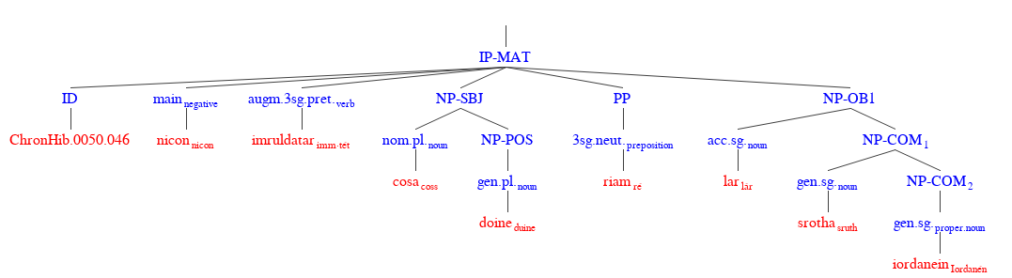
Deriving a treebank from the ChronHib corpus
nicon imruldatar cosa doine riam lar srotha iordanein
Step (4) Final result: Tree Diagram
Elliott Lash Chronologicon Hibernicum Maynooth University

Slide 33
Limitations in the use parsed data for dating texts
- Stability of major structural patterns over long periods of time: e.g. VSO word order.
- Interesting constructions are often extremely rare even in the more extensive ChronHib corpus. Tracing incipient reanalysis of these structure is therefore difficult: e.g. salient unaccusatives.
Accidental gaps in attestation: e.g. paucity of large 10th c. texts.
Elliott Lash Chronologicon Hibernicum Maynooth University

Slide 34
David Stifter
Chronologicon Hibernicum (ChronHib)
Thank you very much for your attention
ERC Consolidator Grant 2015, H2020 #647351

